Slide 1

Probabilistic Risk Assessment: overview, uses and data-related issues
Dr. Manuela Di Mauro
Programme Officer – Risk Knowledge Section
United Nations Office for Disaster Risk Reduction

Slide 2
Background
      BEng and MEng in geophysics, river basin management and numerical modelling
      PhD in decision making for water and flood risk
      Researcher at the Max Plank Institute (numerical modelling), the Helmholtz Centre for Environmental Research UFZ (hydrological modelling)
      Consulting engineer (flood risk assessment and management for UK and Europe)
      Worked at the Earth Observatory of Singapore on earthquake and tsunami risk assessment and management for Sumatra
      Programme officer for risk assessment at UNISDR (global risk analysis and country-specific risk assessment and capacity building for risk assessment\reduction)
Notes:
Introduction on myself – mixed experience.
I am here to bring the perspective from a stakeholder

Slide 3
Outlines
      Why probabilistic risk assessment?
      Overview of probabilistic risk modelling
      Probabilsitic hazard assessment and its uses
      Exposure data characteristics and examples
      Vulnerability assessment
      Probabilistic risk assessment and its uses
      Data-realated issues
Notes:
Introduction on myself – mixed experience.
I am here to bring the perspective from a stakeholder

Slide 4



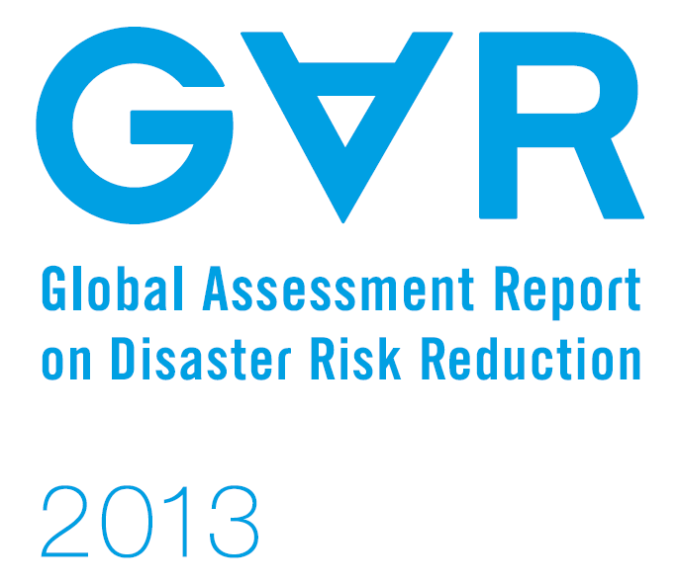
Global Assessment Report
Notes:
The Global Assessment Report has, since 2009, produced information on countries’ risk.

Slide 5













Global Risk Assessment
Notes:
The GAR global risk assessment has been developed in collaboration with a number of partners

Slide 6
Global Risk Assessment
      GAR-09 risk analysis was totally based on previous events listed in international disaster databases.
      For the global risk model we decided to follow the state of the art on risk modelling
      The new global risk model is thus based on a probabilistic risk analysis approach which quantifies losses due to possible future events
      The aim of the global risk assessment is to provide an overview of the risk (and losses) and encourage countries to act upon them. As such, it should note be use at subnational level
      On the other hand, the “risk arithmetic” used for global risk calculation is the same that is used at all scales
Notes:
I am mentioning the GAR as there is a methodological shift on the way the global risk assessment has been carried out

Slide 7
Why probabilistic risk assessment?
      Probabilistic risk assessment provides information on “what”, “how likely” and “how much”
      Consequences calculated by aggregating losses from different events
      Hazard and risk expressed in terms of occurrence rates or exceeding rates
      The uncertainty in the estimation of hazard and vulnerability is captured
      Possibility to compare and aggregate losses from different hazards – multi-hazard risk
Notes:
Why the probabilistic risk assessment is “on fashion” ? A deterministic risk assessment does not allow representing the full variability of the events and their actual probabilities, and does not capture the epistemic or systematic uncertainties.
The risk (as definition) has to express the probability of consequences from different events. Thus it needs to be expressed in terms of occurrence rates.

Slide 8
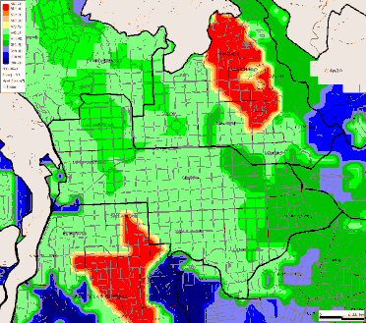
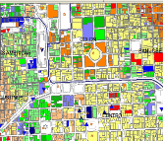

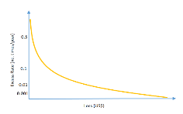
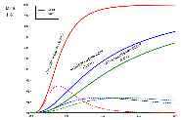
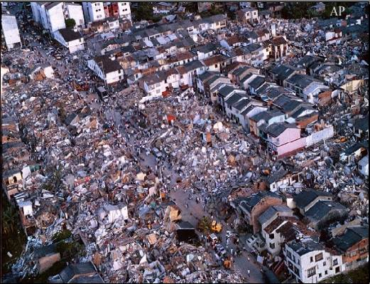
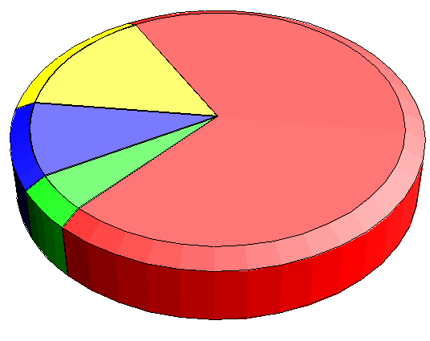
Probabilistic Risk Modeling
Hazard
Damage
Loss exceedance
Exposed assets
Economic
Human
Vulnerability
Notes:
I am going through a quick overview on the probabilistic risk assessment, mainly from the perspective of the modelling. Possibly most of what I am going through is something you are familiar with, thus I will skim through quicky and please stop me if there is anything you wish to discuss further.
Here there is a simple schematisation of the probabilistic risk modelling: that is basically the convolution of a series of hazard scenarios (probabilistically defined) and an exposure dataset, through the asset’s vulnerability (which is also defined probabilistically). Usually the uncertainty in the definition of the exposed elements is not icluded, but it could be potentially be introduced with the same technique
The damages are therefore assessed with their probability of occurrance and theri variance, from which it is posible to calculate their exceedance probability and the “loss exceedance curve”

Slide 9

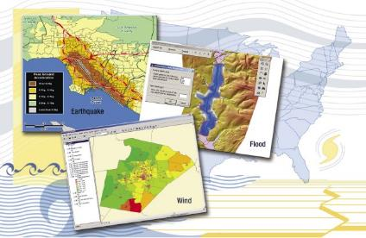
Probabilistic risk modelling tools
HAZUS-MH
MULTI HAZARD RISK ASSESSMENT
www.fema.gov/hazus
Notes:
In terms of free probabilistic modelling tools, there are not many available covering different hazards. Some examples are

Slide 10
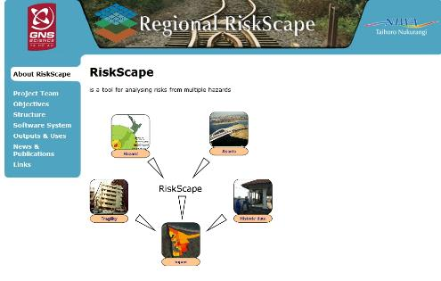
Probabilistic risk modelling tools
RISKSCAPE
MULTI-HAZARD IMPACT AND RISK ASSESSMENT TOOL
(under development)
www.riskscape.org.nz/

Slide 11



Probabilistic risk modelling tools
CAPRA
COMPREHENSIVE APPROACH TO PROBABILISTIC RISK ASSESSMENT
www.ecapra.org
Notes:
CAPRA, developed by the World Bank GFDRR, IDB and UNISDR

Slide 12



Probabilistic risk modelling tools
Notes:
Proprietary tools developed for the insurance market
The techniques, data needs and some parts of the methodologies vary, but the fundaments are quite similar. I am quickly going through them, starting from the most commonly used characteristics of the formats of hazard, exposure and vulnerability data

Slide 13
Probabilistic Risk Modeling
Hazard
Damage
Loss exceedance
Exposed assets
Economic
Human
Vulnerability
Notes:
I am going through a quick overview on the probabilistic risk assessment, mainly from the perspective of the modelling. Possibly most of what I am going through is something you are familiar with, thus I will skim through quicky and please stop me if there is anything you wish to discuss further.
Here there is a simple schematisation of the probabilistic risk modelling: that is basically the convolution of a series of hazard scenarios (probabilistically defined) and an exposure dataset, through the asset’s vulnerability (which is also defined probabilistically). Usually the uncertainty in the definition of the exposed elements is not icluded, but it could be potentially be introduced with the same technique
The damages are therefore assessed with their probability of occurrance and theri variance, from which it is posible to calculate their exceedance probability and the “loss exceedance curve”

Slide 14
Probabilistic Risk Modeling
Hazard
Damage
Loss exceedance
Exposed assets
Economic
Human
Vulnerability
Notes:
I am going through a quick overview on the probabilistic risk assessment, mainly from the perspective of the modelling. Possibly most of what I am going through is something you are familiar with, thus I will skim through quicky and please stop me if there is anything you wish to discuss further.
Here there is a simple schematisation of the probabilistic risk modelling: that is basically the convolution of a series of hazard scenarios (probabilistically defined) and an exposure dataset, through the asset’s vulnerability (which is also defined probabilistically). Usually the uncertainty in the definition of the exposed elements is not icluded, but it could be potentially be introduced with the same technique
The damages are therefore assessed with their probability of occurrance and theri variance, from which it is posible to calculate their exceedance probability and the “loss exceedance curve”

Slide 15
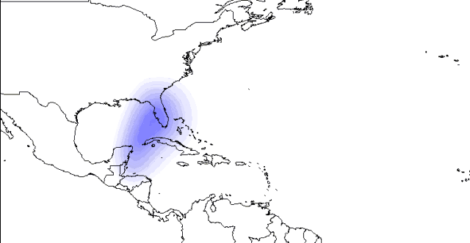
Hazard data
  In probabilistic risk modelling, hazard is represented as a set of stochastic scenarios

Slide 16
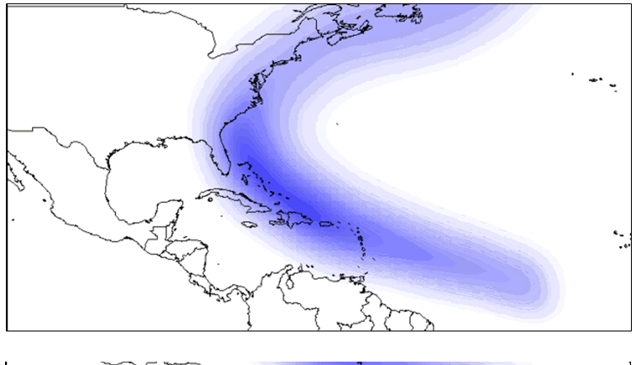
Hazard data
  In probabilistic risk modelling, hazard is represented as a set of stochastic scenarios
  Mutually exclusive and collectively exhaustive
  Annual frequency of occurrence
  Spatially distributed intensity
  Intensity represented by physical characteristic(s) (e.g. flood depth and velocity, wind speed, spectral acceleration etc)
  Intensity described with two statistical moments

Slide 17
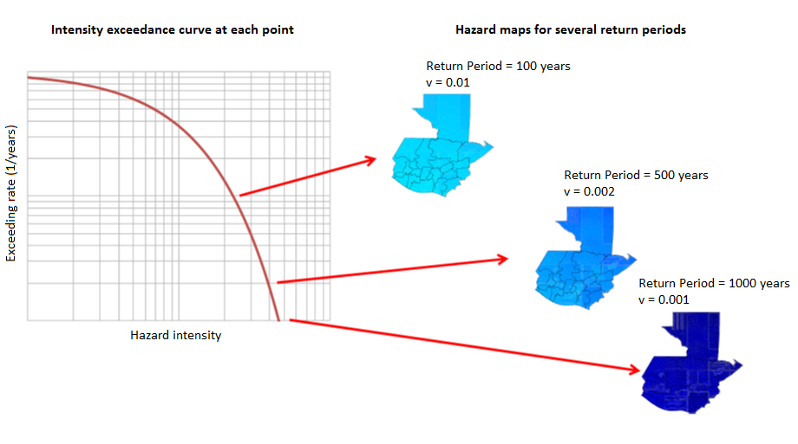
Intensity exceedance curve
<
Notes:
In each point of the domain, for each value a of the intensity along a scale, the probability of exceeding this value a is calculated
In this way, it is possible to building an intensity exceedance curve at each point of the domain. This curve tells what is the probability of exceeding a certain value of intensity in a point of the space (for example, a flood depth of 3 meter at a levee, or a PGA of 0.3g in a certain urban area)

Slide 18
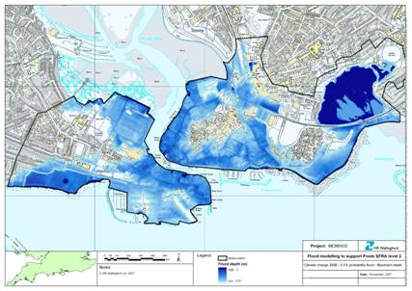
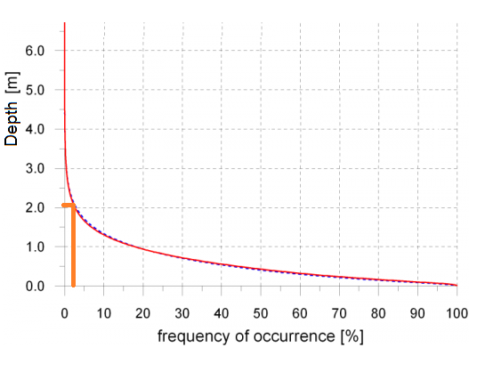
Intensity exceedance curve practical uses
Notes:
Here there is an example: the map was produced for a strategic flood risk assessment (Poole, UK), and shows not a specific, physical scenario: the depth represented here is the results of a combination of scenarios, and is the depth with an exceedance probability of about 0.5%

Slide 19
Intensity exceedance curve practical uses
  Useful (and used) for dimensioning the built environment as well as designing risk reduction interventions:
      Definition of building codes
      Dimensioning of drainage systems
      Design of levees, bridges, breakwater…
      Choice of type and design of telecommunication networks
      Develop land use policies
      Acquire emergency supplies
Notes:
This curve provides the likelihood that a certain intensity is surpassed exceeded, thus it is extremely useful to design for interventions, but also to properly dimension structures so that they can withstand the hazard. Not only, but they provide information in the likelihood that the design choice to be inadequate, thus causing potential damages etc. which is an important information in terms of cost-benefit but also a potential liability issue, with political and sometime legal consequences.

Slide 20
Probabilistic Risk Modeling
Hazard
Damage
Loss exceedance
Exposed assets
Economic
Human
Vulnerability
Notes:
Moving to the next component of a probabilistic riks assessment, I am going to touch quickly on exposure data, what they are and how they are organised

Slide 21
Probabilistic Risk Modeling
Hazard
Damage
Loss exceedance
Exposed assets
Economic
Human
Vulnerability
Notes:
Moving to the next component of a probabilistic riks assessment, I am going to touch quickly on exposure data, what they are and how they are organised

Slide 22
Exposed assets
  Exposure data identify and characterize critical assets susceptible to damage in the occurrence of hazardous events e.g.:
    Urban buildings
    Urban infrastructure
    Rural areas
    Infrastructures
    Human exposure
  Typical information needed:
    Geographical location
    Structural characteristics
    Replacement values
    Human occupation
    Socio-economic characteristics of the occupants
Notes:
Exposure identifies different types of physical entities that are “on the ground”. Exposure data include built assets but also infrastructure, agricultural and human exposure.
The exposure data should contain the physical location o the asset but also the characteristics of the asset that influence its vulnerability and enable the assessment of the damage or loss to the asset. These characteristics include

Slide 23
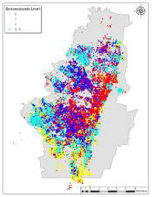
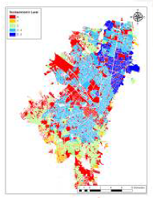
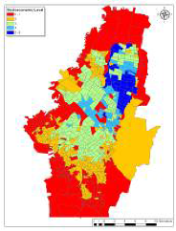
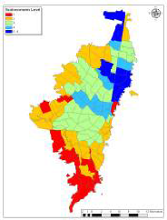
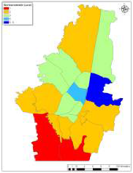
Exposed assets
    They can be represented with different resolutions
    by building
    block
    neighbourhood
    district
    county
Notes:
The exposure can be represented in different resolutions, which depend on the scope of the analysis, the availability of data, as well as the time and the resources that can be employed in the study

Slide 24
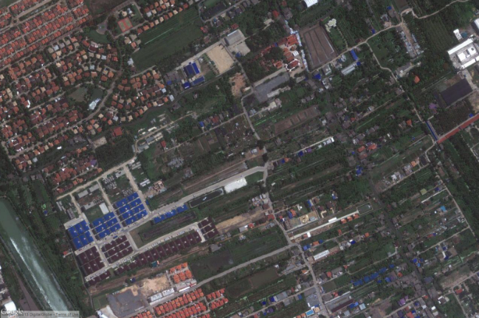
Exposed assets
examples
    Example of exposure data – high resolution
Type: Reinforced concrete
Area: 80 sqm
Occupancy: 8 people
Use: Residential
Value: 20,000 US$
Type: Precast reinforced concrete frame with masonry infill walls
Area: 200 sqm
Occupancy: 100 people
Use: Mixed (residential and offices)
Value: 100,000 US$
Notes:
24

Slide 25
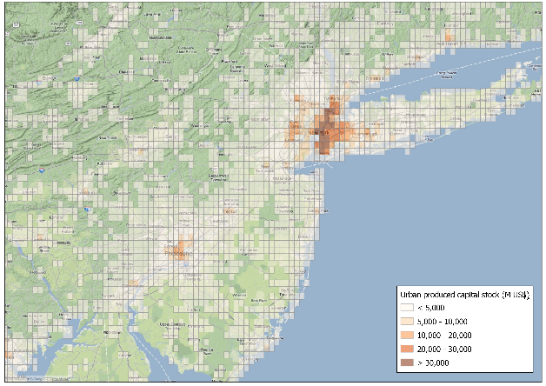
Exposed assets
examples
    Example of exposure data – low resolution
Type: 20% Precast reinforced concrete frame; 40% reinforced concrete; 40% wood frame and masonry infill walls
Area: 25 sqKm
Use: 60% residential; 5% schools; 15% hospitals; 20% offices
Value: 250,000 MUS$
Notes:
25

Slide 26
Probabilistic Risk Modeling
Hazard
Damage
Loss exceedance
Exposed assets
Economic
Human
Vulnerability
Notes:
The exposed assets is combined with the hazard information throuhg the use of vulnerability functions

Slide 27
Probabilistic Risk Modeling
Hazard
Damage
Loss exceedance
Exposed assets
Economic
Human
Vulnerability
Notes:
The exposed assets is combined with the hazard information throuhg the use of vulnerability functions

Slide 28
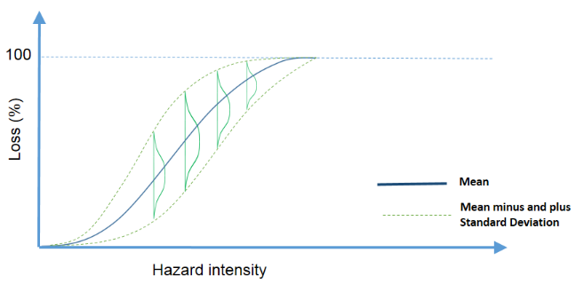
Vulnerability functions
    Vulnerability is represented using mean damage ratios and variance values at different hazard intensities for each characteristic construction type
Notes:
Vulnerabiltiy functions link the intensity of the hazard with the degree of loss of the exposed asset. Each of these measure is not deterministic, as each point of the curve is associated to a probability distribution (usually a gamma distribution)
28

Slide 29
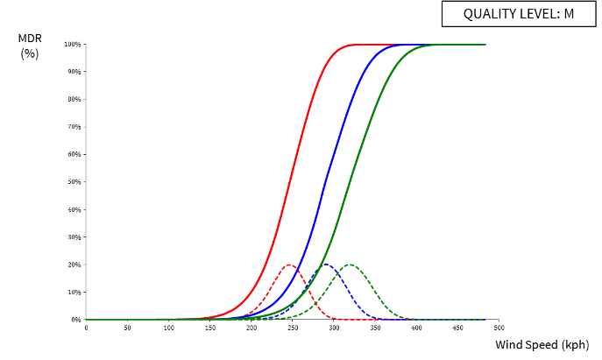
Vulnerability functions
    Hazard intensity parameters can be, for example:
        Earthquakes: spectral acceleration
        Wind: maximum wind speed
        Flood: water depth
Notes:
Different curves are produced for different hazard’s intensity parameters, as well as for different construction types
29

Slide 30
Probabilistic Risk Modeling
Hazard
Damage
Loss exceedance
Exposed assets
Economic
Human
Vulnerability
Notes:
The last element on the equation is the calculation of the risk

Slide 31
Probabilistic Risk Modeling
Hazard
Damage
Loss exceedance
Exposed assets
Economic
Human
Vulnerability
Notes:
The last element on the equation is the calculation of the risk

Slide 32
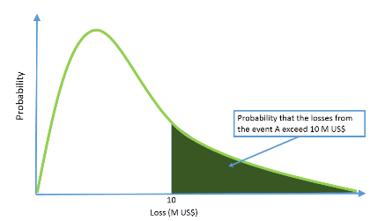
Probabilistic Risk Assessment
Notes:
The last element on the equation is the calculation of the risk

Slide 33
Probabilistic Risk Assessment
Notes:
The last element on the equation is the calculation of the risk

Slide 34
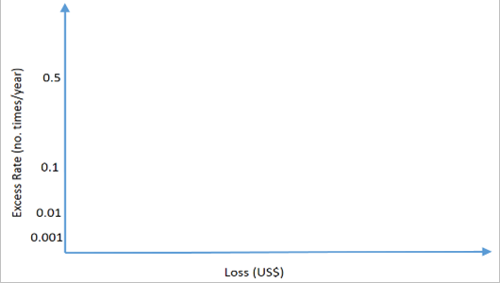
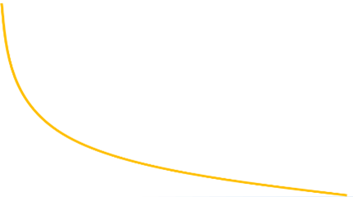
Probabilistic Risk Assessment
Notes:
The last element on the equation is the calculation of the risk

Slide 35
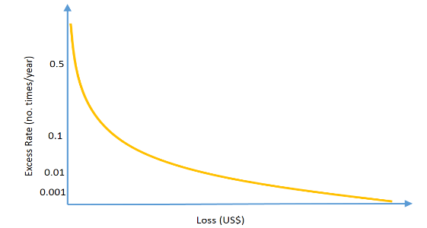
Probabilistic Risk Assessment
Loss exceedance curve
Each point in this curve is the sum of the probabilities P(x > X) for all the events, each multiplied by their frequency of occurrence
Each point of the curve is not associated to a specific event, but it is the absolute probability of having a loss equal or higher than X (“Excess Rate”) in one year
Notes:
Therefore, combining all the exceedance probabilities for different sampled values of the losses, combined with their

Slide 36
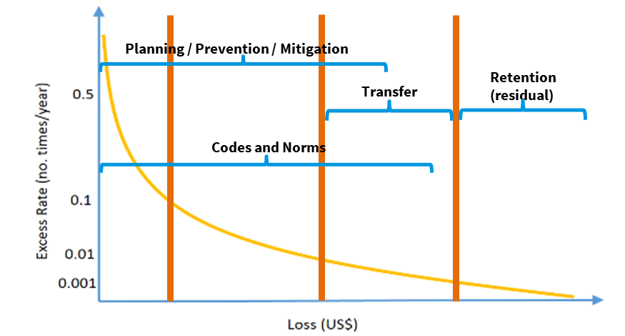
Loss exceedance curve practical uses
1
2
3
4
1 = high probability and low or moderate losses
2 = medium probability and moderate or high losses
3 = low probability and high losses
4 = low probability and very high losses

Slide 37
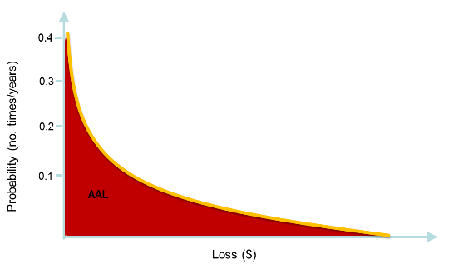
Loss exceedance curve practical uses
Annual Average Losses (AAL)
Information on risk reduction investments’ return
Comparing AALs (e.g. with\without interventions) for cost benefit analysis
Asset-specific Expected Annual Damage (“pure premium”)
Notes:
The Annual Average Losses are the expected losses in every given year (averaged over a long period of time). This is simply the integral of the loss exceedance curve
For example, if the losses are expressed as monetary value, in terms of replacement cost of urban buildings. Thus these results provide a picture of the extent of monetary losses the countries are likely to face, on average, in one year;

Slide 38
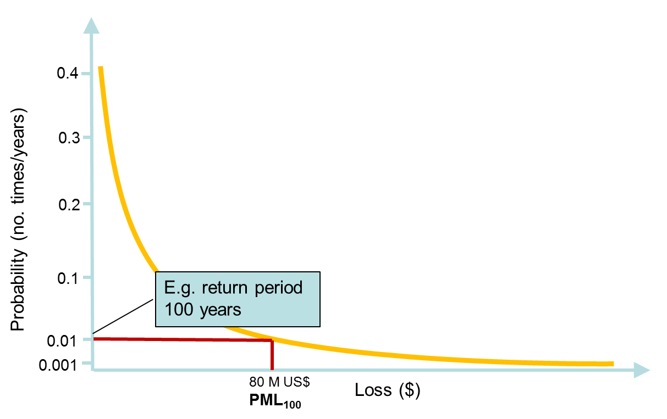
Loss exceedance curve
practical uses
Probable Maximum Losses (PML)
  Maximum loss that could be experienced in the occurrence of a disaster with a particular return period
  Assess losses should the design return period is exceeded
  Plan for emergency interventions
Notes:
provide an estimate of the possible extent of losses that a country could face should a “big” event occur

Slide 39
Loss exceedance curve
practical uses
Bankruptcy probability
  Probability of reaching or exceeding a given PML for a given return period
  Inform policy and cost-benefit on useful life of risk reduction interventions
Notes:
The bankruptcy probability is a nice indicator as it can be compared with the useful life of a structure.

Slide 40
Probabilistic Risk Modeling
Hazard
Damage
Loss exceedance
Exposed assets
Economic
Human
Vulnerability
Notes:
The last element on the equation is the calculation of the risk

Slide 41
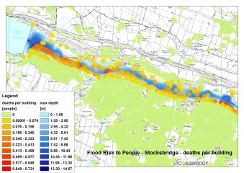
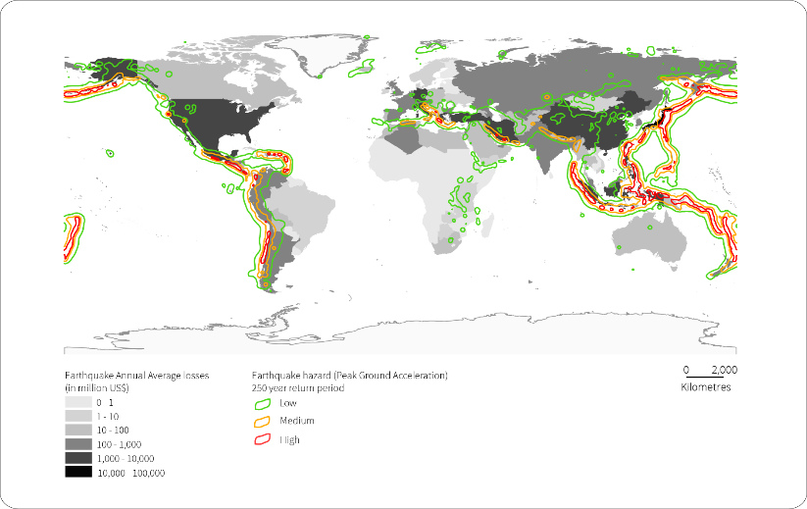
Probabilistic risk assessment data-related issues
Designing a risk assessment
Risk assessment to respond to specific questions – determine scale and resolution
Notes:
Here there are some general questions (that might lead into issues) when approaching a risk assessment:
First, we need to determine which are the questions we are trying to answer, thus the specific scope of the risk assessment. This will inform in the choice of the best resolution and scale of the analysis
These factors are also obviously dependant on the time, resources and type/resolution of data available
There is also the question on which hazard we are trying to assess the risk for – mostly will depend on the context of the specific questions we are trying to answer, but sometimes the modellers are asked to take this decision, thus a pre-assessment of the risks in the area is necessary.

Slide 42
Probabilistic risk assessment data-related issues
Designing a risk assessment
Risk assessment to respond to specific questions – determine scale and resolution
Once this is defined, appropriate modelling assumptions are selected
Time, resources, data available also influence the resolution
Multi-hazard vs hazard selection \ prioritisation
Use the risk assessment according to the scope for which it has been produced
Notes:
Here there are some general questions (that might lead into issues) when approaching a risk assessment:
First, we need to determine which are the questions we are trying to answer, thus the specific scope of the risk assessment. This will inform in the choice of the best resolution and scale of the analysis
These factors are also obviously dependant on the time, resources and type/resolution of data available
There is also the question on which hazard we are trying to assess the risk for – mostly will depend on the context of the specific questions we are trying to answer, but sometimes the modellers are asked to take this decision, thus a pre-assessment of the risks in the area is necessary.

Slide 43
Probabilistic risk assessment data-related issues
Hazard - format
Event-by-by event data with assigned return periods needed
Assumption of “mutual exclusivity” of the events, need for calculating correlations of events
Definition of the physical quantity describing the hazard intensity according to the vulnerability curves
Hazard defined with its spatial variability
Two statistical moments in each point of the domain provided
Resolution of the hazard model compatible with the required resolution of the risk calculation
Notes:
Common issues when defining the hazard data for probabilistic risk assessment are the following:
One of the main issue is posed by the need of the events to be “mutually exclusive”, as for events that are correlated, a subset of the event has to be produced, taking into account the joint probability of these.
In some cases, the model deployed for calculating the hazard do not provide characteristics that are important for assessing the losses , as mentioned earlier
In other cases, only one absolute value can be obtained, rather than the two statistical moments
And of course the resolution of the hazard model has to be compatible with the resolution of the expected results to avoid downscaling

Slide 44
Probabilistic risk assessment data-related issues
Hazard - input
Assess the quality of the input to the hazard model (and its propagation to the output )-> uncertainty analysis
Completeness and accuracy of temporal series e.g. rainfall, discharges, catalogues (e.g. earthquake and cyclones)
Specific characteristics measured differently between datasets (e.g. weir types for discharges, or sampling intervals or time windows etc)
Resolution and availability of topographic and bathymetric data
Accuracy of land use and land cover maps, importantly affecting different hazards (especially flood and wind)
Notes:
Regarding the issues in the data that goes as input of the hazard models
In general, one of the main issues in the input data it is posed when it is not possible to assess the quality of the input data. This occurs when they do not come without uncertainty bands, thus is impossible to calculate the propagation of this uncertainty to the output
It is also important to establish the completeness of the time series, which can be done running statistical analysis – although the series can be expanded only to a certain point
It is important that there is coherence in the way the data are measured, for example among stations in different sub-basins, as it creates a huge issue to try to harmonise them (sometimes leading to discard measurements or to make assumptions that only add uncertainty in the output)
A major issue, especially in developing country, is to have good and available topographic or bathymetric data
Also, land cover influences greatly the propagation and characteristics of different hazard, and it is therefore important to have good information on this

Slide 45
Probabilistic risk assessment data-related issues
Vulnerability
Model sensitive to vulnerability curves
Lab-based and validated through real data but possibly area-specific
Confidentiality issue or proprietary vulnerability curves not available
Hazard intensity measures influencing vulnerability might not be calculated
Human vulnerability still not well defined
Exposure
Difficulty in defining the structural type and assign the correct vulnerability curve
Issue in attributing replacement values – also depending on the scope of the analysis
Notes:
I will now touch quickly on some of the issue related to the definition of vulnerability and exposure
The vulnerability curves are probably the weakest point in the risk assessment. The model’s results are quite sensitive to these curves and the definition of uncertainty at the points, which are mostly based on laboratory experiments and validated with real data. This makes them very dependant on the construction techniques used in the analysis, thus makes them potentially area-specific.
There is also an issue on disclosing vulnerability data
Sometimes it is also not possible to match the intensity characteristic measure produced with the hazard assessment with what it would be required by a good vulnerability analysis (example of flood velocity, momentum and scour etc)
The characterisation of the human vulnerability is also a open research question. It can be the physical vulnerability or the consequence to building collapse etc, but for some hazards, factors such as early warning are really relevant.
In building the exposure databases, the main issue is to define the correct “class” to the exposed element, for example “Ductile reinforced concrete moment frame with or without infill”. Such characteristics are only known if to the visual inspection is coupled with knowledge of the building design or codes etc. Same issues with definition and location of population.
The correct replacement value of the building can change depend on the scope of the risk assessment (e.g. physical construction value, market value etc)

Slide 46
Thank you
www.preventionweb/gar
Planning / Prevention / Mitigation
Transfer
Retention
(residual)
Codes and Norms

Slide 47
About..
Notes:
I would like to conclude with a quick overview of the risk modelling work that we have carried out for GAR13

Slide 48
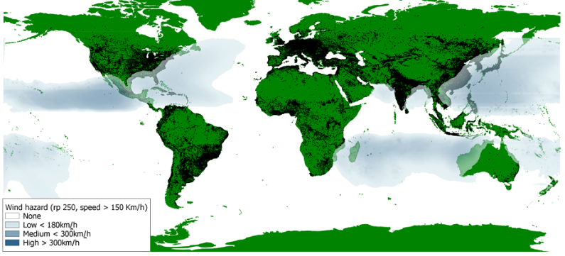
Global wind hazard assessment
  Cyclonic wind hazard for different return periods, developed using the open source program ERN-Hurricane (www.ecapra.org)
Notes:
The hazard from cyclonic wind, in terms of wind speed, was calculated for 50, 100, 250, 500 and 100 years return periods. This hazard was also calculated by CIMNE and Associates through the open source program ERN-Hurricane

Slide 49
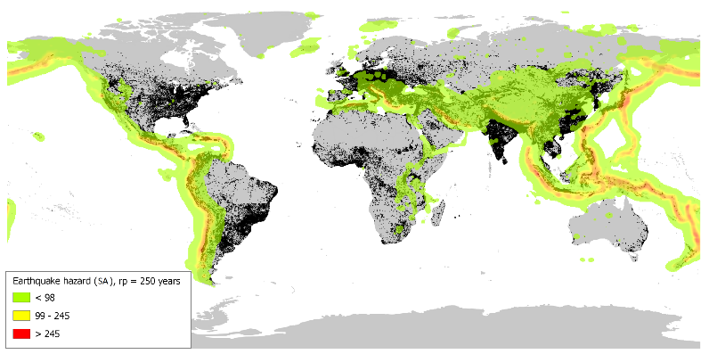
Global seismic hazard assessment
  Earthquake Hazard for different return periods, developed using the open source program CRISIS2012 (www.ecapra.org)
Notes:
Regarding the “hazardous events” that we mentioned earlier, they were determined for different types of hazard and different probability of occurrence.
Earthquake hazard was calculated in terms of spectral acceleration for 250, 475, 1000, 1500, 2500 years return periods. This work was carried out by CIMNE and Associates, in collaboration with the Global Earthquake Model, through the open source program CRISIS2012

Slide 50
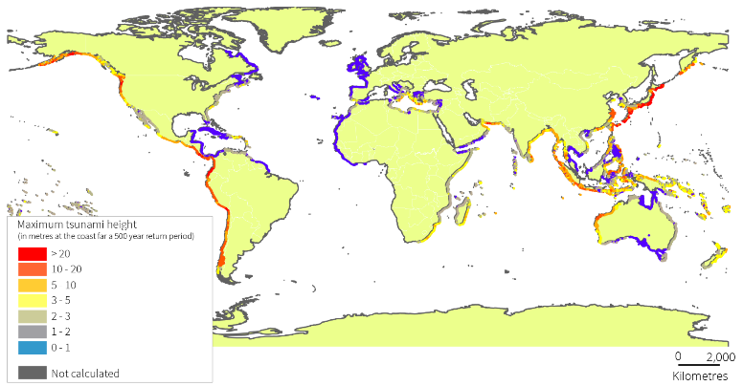
Global tsunami hazard assessment
  Tsunami hazard for ~1 in 500 years return period
Notes:
The tsunami hazard was calculated by NGI, in collaboration with Geoscience Australia, for one return period in terms of run-up height and water depth

Slide 51
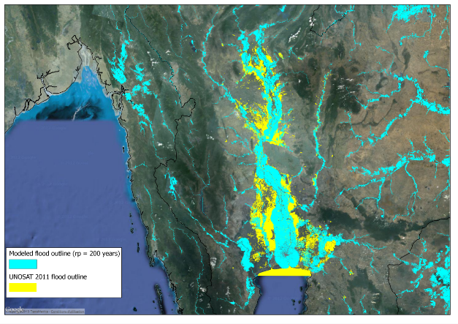
Global flood hazard assessment
  Global Flood Model, pilot study for Thailand
Notes:
The global flood model it’s under development by CIMA and UNEP-GRID and will be ready in 2015. For 2013, results in terms of flood depth for 25, 50, 100, 200, 500, 1000 years return periods are available for Thailand

Slide 52
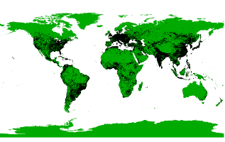
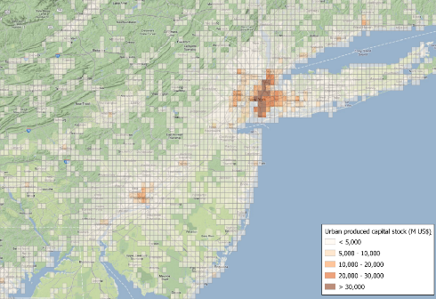
Global Exposure Database
The Global Exposure Database provides the distribution of the value of the urban built environment around the world in a 5Km x 5 Km grid
Notes:
To calculate the expected consequences on the built environment (in our case, in the form of economic losses) from any hazard, the first thing that is needed to know is “what’s on the ground”, thus the value and the structural characteristics of the exposed assets
For this, a “Global Exposure Database” was developed by UNEP-GRID in collaboration with CIMNE and Associates. This database contains the value of the urban buildings in a 5Kmx5Km grid

Slide 53
Global Risk Assessment
Notes:
The Annual Average Losses and Probable Maximum Losses for 250 years return period are available for earthquakes and tropical cyclones for every country in the world . Here we can see the distribution of Annual Average Losses due to earthquakes

Slide 54
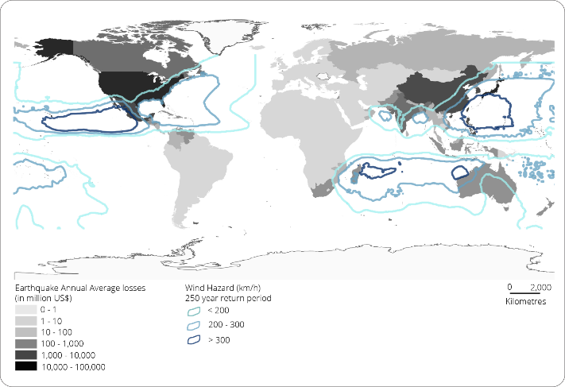
Global Risk Assessment
Notes:
And this figure shows the distribution of Annual Average Losses due to cyclonic wind

Slide 55
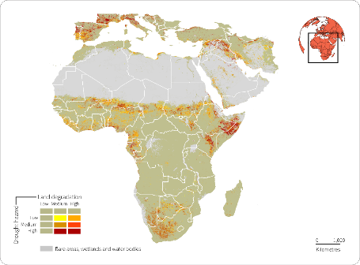
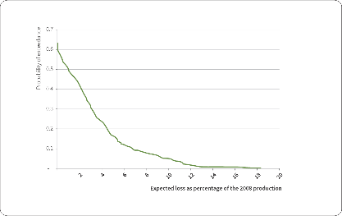
Drought Hazard and Risk
  Agricultural drought hazard for Africa and the Mediterranean Regions between 2000 and 2010
  Assessment of likelihood of crop losses for Mali, Niger, Mozambique and Kenya
Notes:
We are also working to assess agricultural drought hazard and risk:
ACSAD collected and elaborated data from 2000 to 2010 to produce the maps of past agricultural drought and land degradation for Africa and the Mediterranean Regions.
FEWS-NET has developed a model for calculating crop loss-exceedance curves annual average losses of crops in four African countries (Mali, Niger, Mozambique and Kenya)

Slide 56
All the GAR13 (and more) data available from: www.preventionweb/gar
Further information on data uses, methods and tools in the
Global Assessment Report 2013 Annex 1
Notes:
Once more, I would like to stress that all the data are available and downloadable form the GAR website.
If you want to read more on the data typologies and the methodologies used to produce them, please refer to the Annex 1 of the GAR13 and all the background papers referenced in this Annex, also available on the GAR website

Slide 57
Thank you
www.preventionweb/gar
Planning / Prevention / Mitigation
Transfer
Retention
(residual)
Codes and Norms

